Slide 1

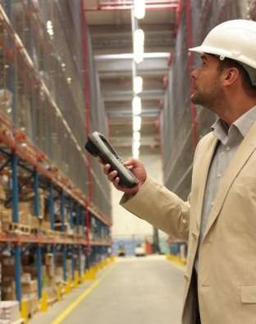
INVENTORY MANAGEMENT

Slide 2
Introduction
The term inventory means the value or amount of materials or resource on hand. It includes raw material, work-in-process, finished goods & stores & spares.
Inventory Control is the process by which inventory is measured and regulated according to predetermined norms such as economic lot size for order or production, safety stock, minimum level, maximum level, order level etc.
Inventory control pertains primarily to the administration of established policies, systems & procedures in order to reduce the inventory cost.

Slide 3
OBJECTIVES OF INVENTORY CONTROL
To meet unforeseen future demand due to variation in forecast figures and actual figures.
To average out demand fluctuations due to seasonal or cyclic variations.
To meet the customer requirement timely, effectively, efficiently, smoothly and satisfactorily.
To smoothen the production process.
To facilitate intermittent production of several products on the same facility.
To gain economy of production or purchase in lots.

Slide 4
To reduce loss due to changes in prices of inventory items.
To meet the time lag for transportation of goods.
To meet the technological constraints of production/process.
To balance various costs of inventory such as order cost or set up cost and inventory carrying cost.
To balance the stock out cost/opportunity cost due to loss of sales against the costs of inventory.
To minimize losses due to deterioration, obsolescence, damage, pilferage etc.
To stabilize employment and improve lab our relations by inventory of human resources and machine efforts.

Slide 5
Important Terms
Minimum Level– It is the minimum stock to be maintained for smooth production.
Maximum Level – It is the level of stock, beyond which a firm should not maintain the stock.
Reorder Level –The stock level at which an order should be placed.
Safety Stock – Stock for usage at normal rate during the extension of lead time.
Reserve Stock - Excess usage requirement during normal lead time.
Buffer Stock – Normal lead time consumption.

Slide 6
Inventory Costs
Carrying cost
cost of holding an item in inventory
Ordering cost
cost of replenishing inventory

Slide 7
Inventory Control Systems
constant amount ordered when inventory declines to predetermined level
order placed for variable amount after fixed passage of time
Continuous system (fixed-order-quantity)
Periodic system
(fixed-time-period)

Slide 8
Assumptions of Basic EOQ Model
Demand is known, constant, and independent
Lead time is known and constant
Order quantity received is instantaneous and complete
No shortage is allowed

Slide 9



















Inventory Order Cycle
Order quantity, Q
Demand rate
Inventory Level
Reorder point, R
0
Lead
Lead
Time
time
time
Order Order placedreceipt
Order Order placed receipt

Slide 10













EOQ Cost Model
C_{o} - cost of placing order
C_{c} - annual per-unit carrying cost
D - annual demand
Q - order quantity
C_{o}D Q
C_{c}Q
2
C_{o}D C_{c}Q Q ⁺ 2
Annual ordering cost =
Annual carrying cost =
Total cost =

Slide 11

EOQ Cost Model
Deriving Q_{opt}
C_{o}D C_{c}Q
TC = _{Q} + ₂
∂TC ₌- ^{C}o^{D} ₊ C_{c}
Proving equality of costs at optimal point
C_{o}D C_{c}Q Q 2
=
∂Q
_{Q}2
2
2C_{o}D
₋ C₀D
_{Q}2
_{Q}2
=
₊ ^{C}c
2
C
0 =
c
2C_{o}D
C_{c}
2C_{o}D
C_{c}
^{Q}opt ⁼
^{Q}opt ⁼

Slide 12
















EOQ Cost Model (cont.)
Annual
cost ($)
Total Cost
Slope = 0
C_{c}Q
2
Minimum total cost
Carrying Cost =
C_{o}D
Ordering Cost =
Q
Optimal order
^{Q}opt
Order Quantity, Q

Slide 13



Reorder Point
Level of inventory at which a new order is placed
R = dL
where
d = demand rate per period
L = lead time

